Slide 1

Cancer Research
James Beall
Farai Maramba
Karla Ellsworth

Slide 2




Motivation and Summary
We are interested in analyzing esophageal cancer trends by age, gender, and drug use
We are interested in analyzing esophageal cancer trends by region, age, gender and drug use
Our data was limited so results are not conclusive

Slide 3
Questions and Data
We are interested in analyzing esophageal cancer trends by:
Region
Age
Gender
Drug use

Slide 4
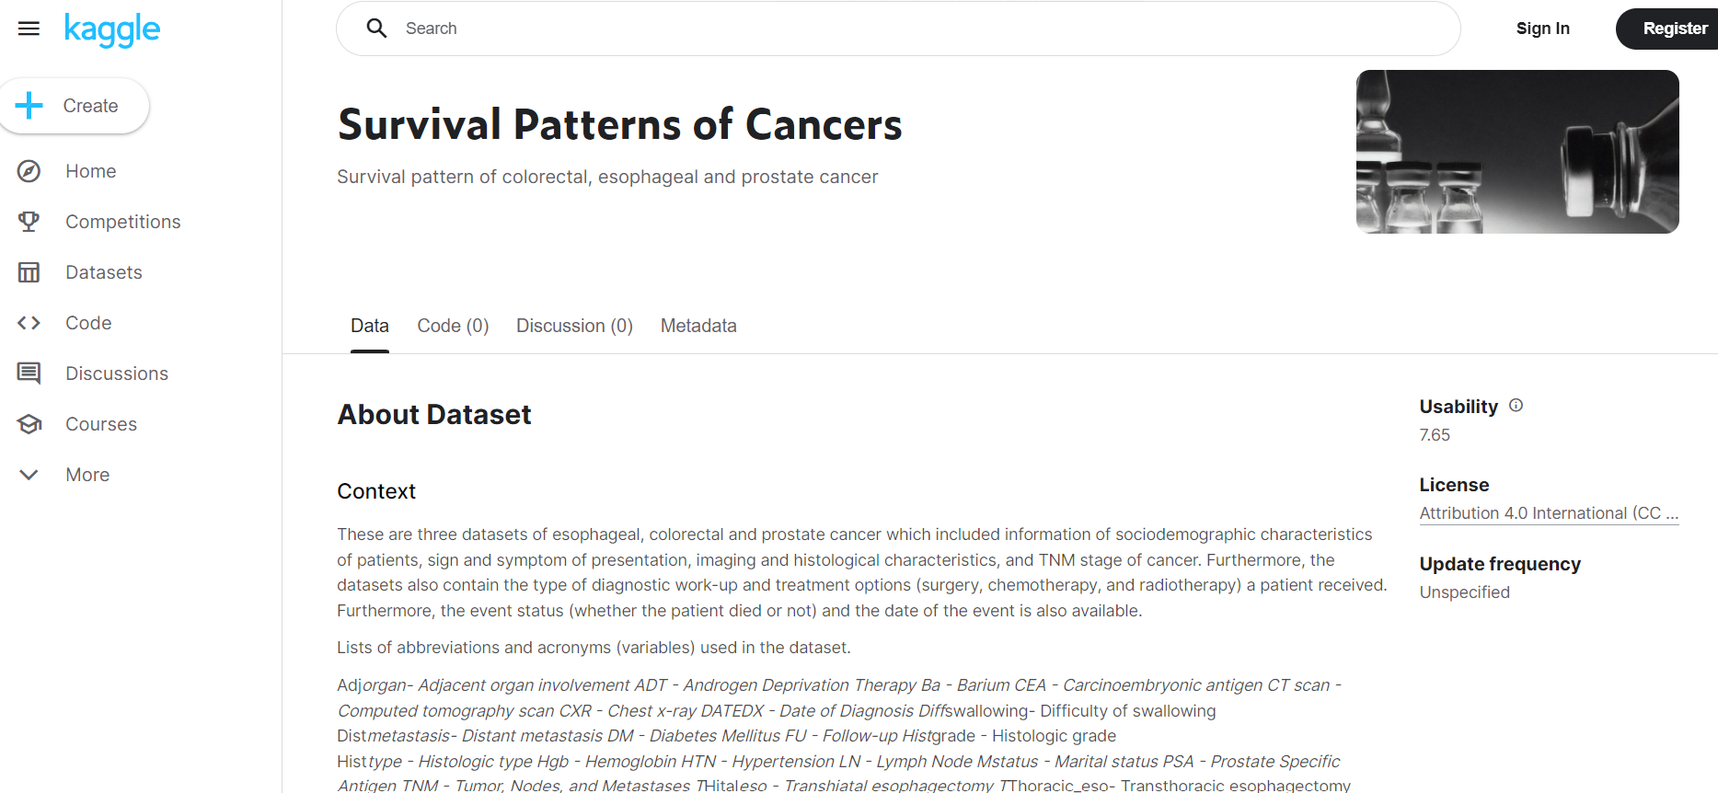
Data Clean up and Exploration

Slide 5
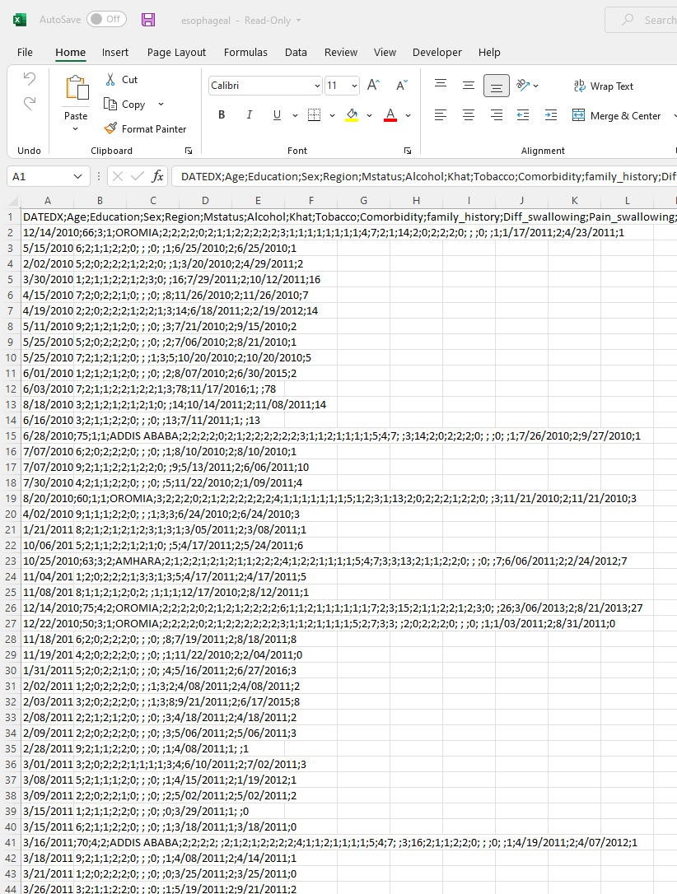
Data Clean up and Exploration

Slide 6
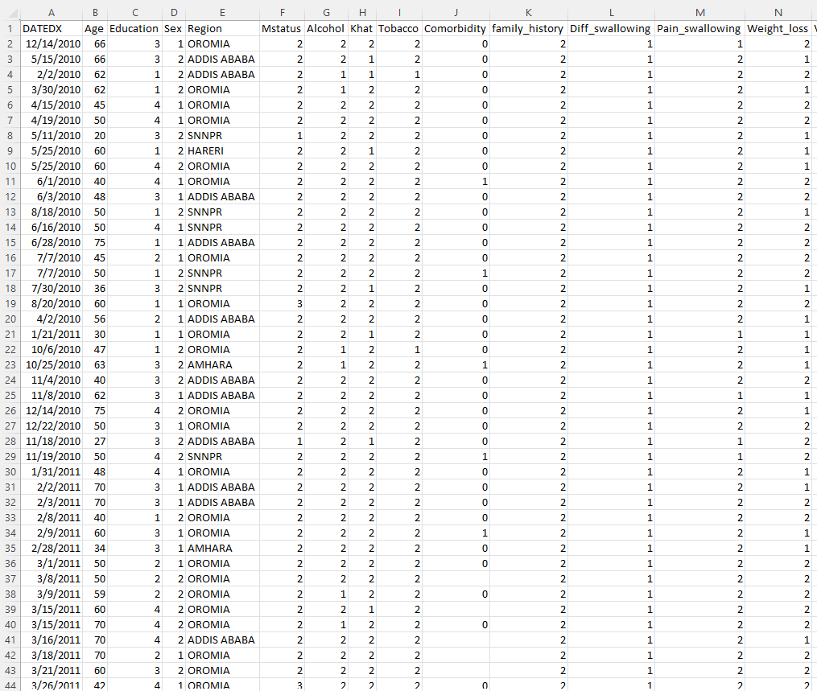
Data Clean up and Exploration

Slide 7

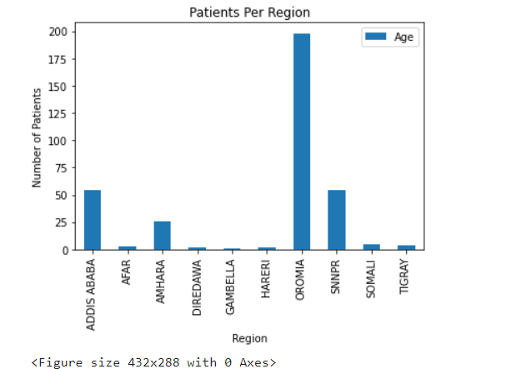
Region Analysis

Slide 8
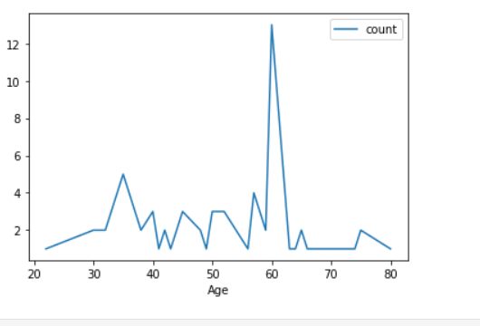
Age Analysis

Slide 9
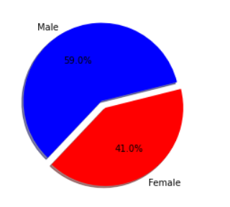
Gender Analysis

Slide 10
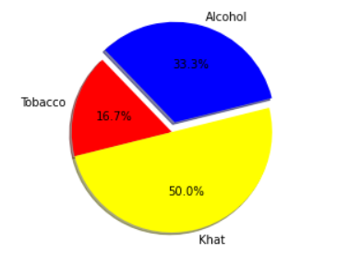
Drug Analysis

Slide 11
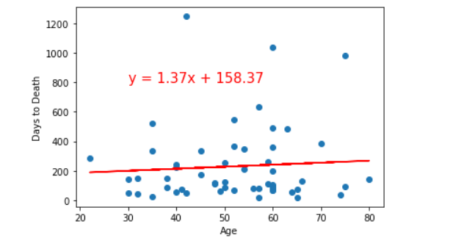
R2 Days to Death vs Age Analysis

Slide 12
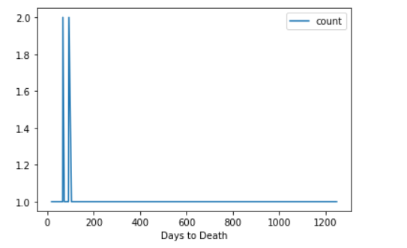
Days to Death Analysis

Slide 13

Discussion
We concluded that 59% of males died from cancer and 41% of females died from cancer. The most cases of cancer occurred in the region of Oromia. The most used drug that caused cancer was Khat which was 50% compared to Alcohol at 33% and Tobacco at 16.7%. There is a spike at 60 years old cancer patients and the average patients dead at 52 years old

Slide 14
Post mortem
Limited data:
349 Data Sets
Geographic
Local
Regional
Khat

Slide 15
Questions
Open Floor Q&A with the audience

Slide 16


Thank You

